Slide 1
Era 2: 1887-1917
Sports become a way of life in the U.S.

Slide 2
Baseball
In 1900, new baseball league formed called the American League
Was a rival to the National League
A lasting agreement was made in 1903
Each league’s champion would play each other in what is called The World Series
Boston beat Pittsburgh 5 games to 3.

Slide 3
Baseball
Did not allow African-Americans to participate
African-Americans tried to create their own league but failed (late 1800s)
African-Americans continued to play in the minor leagues and other independent teams

Slide 4
Boxing
Opposition to the sport continued through the early 1900s.
1910 – Jack Johnson, an African-American from Louisiana, became the heavyweight champ defeating Jim Jeffries
He defended his title again defeating Jeffries a second time
Race riots broke out in large cities like Pittsburgh and Baltimore

Slide 5
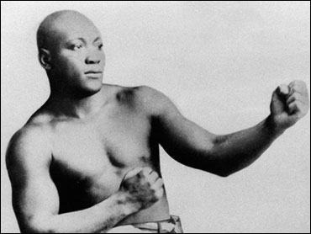
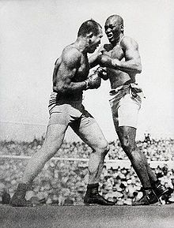

Slide 6
Golf
1888 a Scottish immigrant introduced golf to some friends in New York state
Created a “three-hole” course
Later that year he and his friends created a golfing club
1893 a private country club near Boston added a golf course
Chicago gained 26 courses from 1890-1900
Tournaments created at private courses
The Socially Elite dominated the sport until 1915

Slide 7
Golf
First Professionally designed and constructed course: Shinnecock Hills in Long Island, NY (1891)
Dec 1894 – Amateur Golf Association of the US (later named the US Golf Association)
Men and women participated in separate tournaments
US Open was first played in 1895

Slide 8
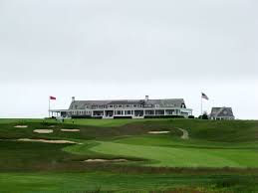
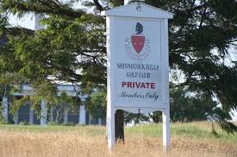

Slide 9
Tennis
Introduced from Europe
Played by socially elite during 1880s-1890s
Was strictly an amateur sport until early 1900s
Men and women participated
1900 - Dwight Davis, encouraged international play donating a trophy to the winner
Davis Cup was established

Slide 10
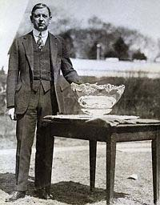
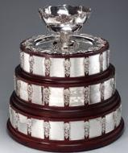

Slide 11
Tennis
More athletic players participated in early 1900s
Gained more popularity among middle class when Maurice McLoughlin became a national champion
McLoughlin was from a middle class background
African-Americans had separate leagues
Washington D.C. and Baltimore hosted tournaments for inner city minorities

Slide 12
The Great Outdoors
League of American Wheelman – bicycle enthusiasts, competed in races
Also helped to promote need for improved roadways in U.S.
National Rifle Association (NRA) founded in 1871 – sponsored shooting tournaments
1900 American Trapshooting Association was formed

Slide 13
Football
By 1890 many colleges established football teams
Rivalries form among many schools:
Army-Navy (1900)
Stanford-California (1892)
Special games:
Thanksgiving Day games are played
New Year’s Day Rose Bowl established 1902

Slide 14
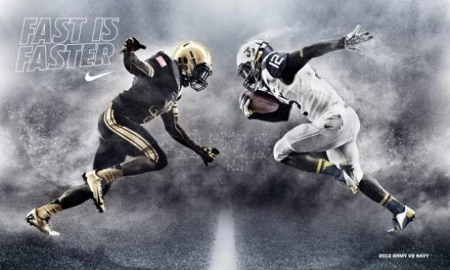

Slide 15
Football
Ex-players begin coaching careers:
Amos Alonzo Stagg
John Heisman
Glen “Pop” Warner
Fielding Yost
African-American colleges compete against one another (1892)

Slide 16
Yearly sports “Rhythms”
Baseball – Spring/Summer
Football – Fall
Basketball - Winter

